Slide 1

Developing AI made Easy
By: Semiu Amao

Slide 2
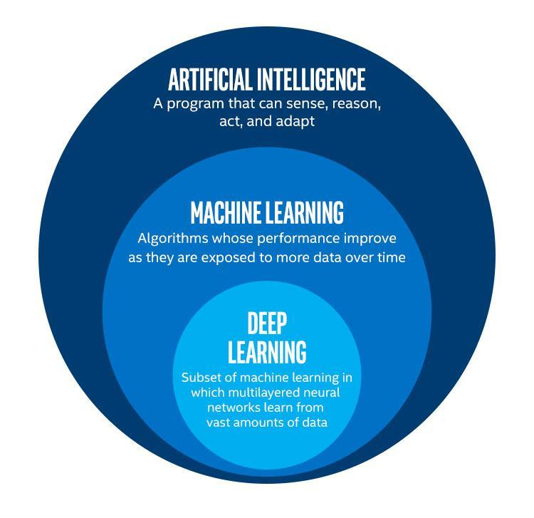

What is Artificial Intelligence?

Slide 3
Components of AI
Data engineering
Machine Learning Algorithm
Create AI

Slide 4
Concept of AI Application
Get a Trained Model
Input to the model
What to do with the Output

Slide 5

Coding …

Slide 6
References
Intel Distribution (Python) - https://software.intel.com/content/www/us/en/develop/tools/distribution-for-python/choose-download.html
Opencv - https://docs.opencv.org/master/d6/d00/tutorial_py_root.html
Openvino Download- https://software.intel.com/en-us/openvino-toolkit/choose-download?innovator=CNCT-0028433
Upcoming Intel Training - http://app.plan.intel.com/e/es?s=334284386&e=8272366&elqTrackId=5230610ebe444712a01408bc4b46a4ea&elq=9c88f0648d5c4b3e8b26bd08a1700c6a&elqaid=65832&elqat=1

